Slide 1
WWII

Slide 2
A Grand Alliance
The Big Three
  Great Britain (Winston Churchill)
  The U.S. (FDR)
  The Soviet Union (Joseph Stalin)
Strategies for War
  Defeat Germany first

Slide 3
Gloomy Prospects for the Allied Powers
By the end of 1942, the Allies faced defeat.
  The chain of spectacular victories disguised fatal weaknesses within the Axis alliance:
    Japan and Germany fought separate wars, each on two fronts. They never coordinated strategies.
  The early defeats also obscured the Allies’ strengths:
    The manpower of the Soviet Union and the productive capacity of the United States.

Slide 4
Invasion of the Soviet Union
It was then that Hitler made his pivotal mistake. He invaded the Soviet Union.
  The obliteration of Bolshevism was a key element of Hitler’s ideology; however, it was a gigantic military mistake.
On June 22, 1941, Hitler launched Operation Barbarossa, consisting of an attack army of 4 million men spread out along a 2,000-mile front in three massive offensives.
The German army quickly advanced, but at a terrifying cost. For the next three years, 90 percent of German deaths would happen on the eastern front.

Slide 5
The Pacific Theater
Within 6 months of Pearl Harbor, Japan had a new empire.
  Greater East Asia Co-prosperity Sphere
    Japanese racial purity and supremacy
      Treated Chinese and Koreans with brutality.
    “Rape of Nanjing”- Japanese slaughtered at least 100,000 civilians and raped thousands of women in the Chinese capital between Dec. 1937 and Feb. 1938.
  Could have consolidated
  “victory disease”
After Pearl Harbor, American military leaders focused on halting the Japanese advance and mobilizing the whole nation for war.

Slide 6
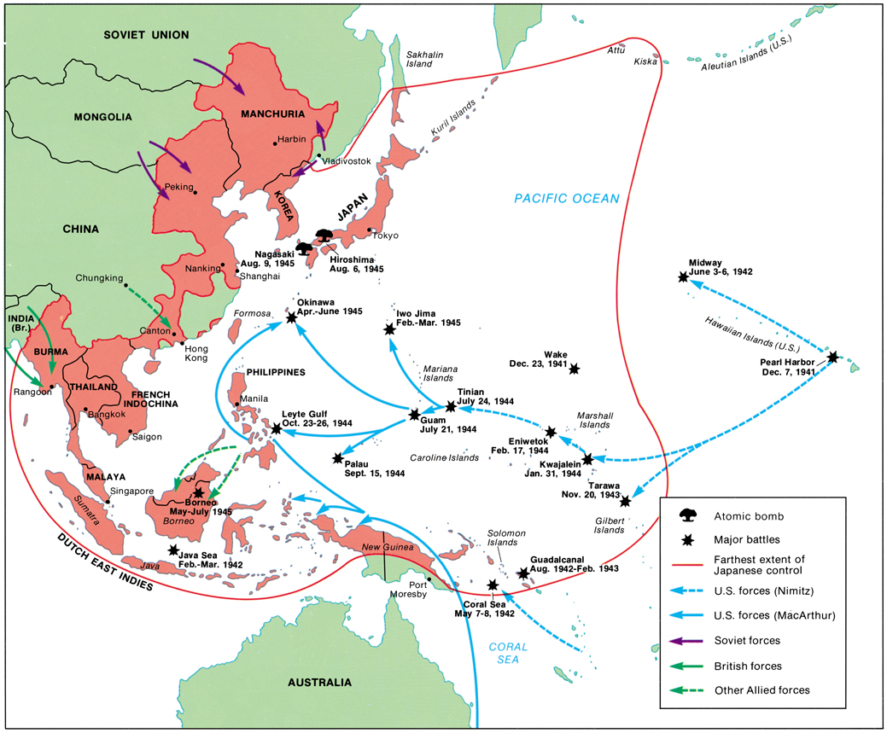

Slide 7
The Pacific Theater:
Early Battles
American Forces halted the Japanese advances in two decisive naval battles.
  Coral Sea (May 1942)
    U.S. stopped a fleet convoying Japanese troops to New Guinea
    Japanese designs on Australia ended
  Midway (June 1942)
    Japanese Admiral Yamamoto hoped to capture Midway Island as a base to attack Pearl Harbor again
    U.S. Admiral Chester Nimitz caught the Japanese by surprise and sank 3 of the 4 aircraft carriers, 332 planes, and 3500 men.
      American cryptanalysts

Slide 8
Importance of Midway
The Japanese defeat at Midway was the turning point in the Pacific.
  Japanese advances stopped.
  U.S. assumes initiative.
  Japanese have shortage of able pilots.
Censorship and Propaganda
  News of the defeat was kept from the Japanese public.

Slide 9
Turning Points of the War: The Battle of Stalingrad
The Battle of Stalingrad was the turning point of the war. The German Army (Wehrmacht) had already lost 2 million men on the eastern front.
In 1942-43, a German army of over 300,000 was defeated and captured at the Battle of Stalingrad.
The Germans then lost the battle of Kursk and began a long retreat.
The Red Army crossed into Poland in January 1944.

Slide 11
Turning Points of the War: Western Front
Operation Torch (1943)
  Allied victory in North Africa and invasion of Italy.
D-Day: Operation Overlord
  The Allied needed to establish a second front.
  General Dwight Eisenhower launched an invasion of Normandy on June 6, 1944.
  An invasion fleet of some 4,000 ships and 150,000 men (57,000 U.S.)
  Invasion successful. 5,000 killed and wounded Allied troops.
  It allowed them to gain a foothold on the continent from which they could push Germany back.

Slide 12
Race to Berlin
D-Day was the turning point of the western front. Stalingrad was the turning point of the eastern front.
The British, U.S., and Free French armies began to press into western Germany as the Soviets invaded eastern Germany.
Both sides raced to Berlin.

Slide 13
Victory in Europe
Mussolini was captured and killed by Italian partisans and Hitler committed suicide in April 1945, as the Russian troops took Berlin.
Germany surrendered unconditionally on May 7, 1945 (V-E Day).
Fighting in the Pacific would continue until August.

Slide 14
Atom Diplomacy
FDR had funded the top-secret Manhattan Project to develop an atomic bomb
Dr. Robert Oppenheimer successfully tested in the summer of 1945.
FDR had died on April 12, 1945, and the decision was left to Harry Truman.
An amphibious invasion could cost over 350,000 Allied casualties.

Slide 15
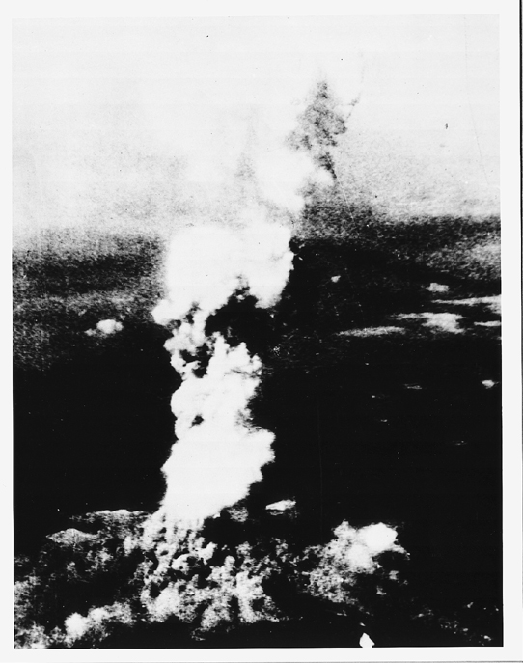
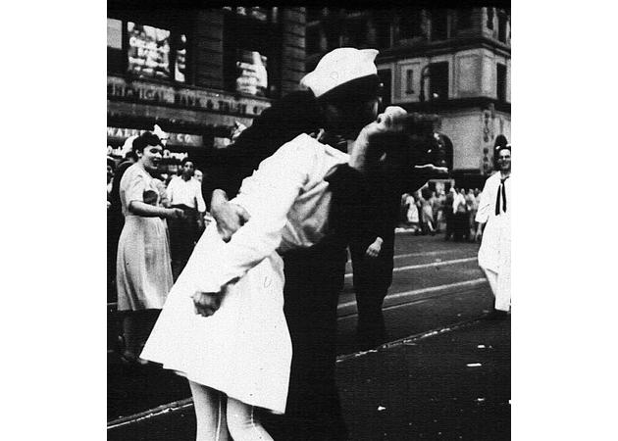
Turning Points of the War: The Pacific
August 6, 1945 – Enola Gay drops bomb on Hiroshima
  140,000 dead; tens of thousands injured; radiation sickness; 80% of buildings destroyed
August 9, 1945 – Nagasaki
  70,000 dead; 60,000 injured
Emperor Hirohito surrenders on Aug. 14, 1945. (V-J Day)
  Formal surrender signed on September 2 onboard the battleship Missouri in Tokyo Bay

Slide 16
Cost of War
Germany- 3 million combat deaths (3/4ths on the eastern front)
Japan – over 1.5 combat deaths; 900,000 civilians dead
Soviet Union - 13 million combat deaths
U.S. – 300,000 combat deaths, over 100,000 other deaths
When you include all combat and civilian deaths, World War II becomes the most destructive war in history with estimates as high as 60 million, including 25 million Russians.

Slide 17
Postwar Efforts at Peace
The United Nations – There was some hope when, in 1945, the United Nations was created; an organization to promote international stability
  A General Assembly where representatives from all countries could debate international issues.
  The Security Council had 5 permanent members – U.S., Soviet Union, Britain, France, and China could veto any question of substance. There were also 6 elected members.
  Key: the U.S. joined in contrast to League of Nations

Slide 18
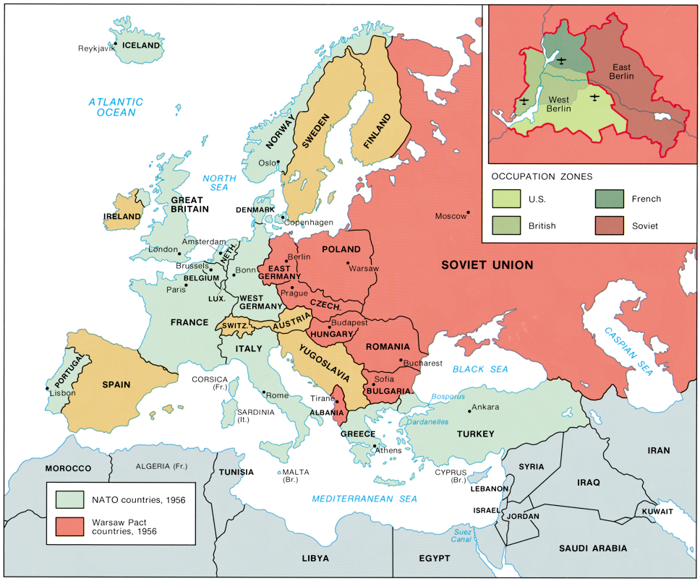

Slide 19
Postwar Reality:
Soviet Control of Eastern Europe
Europe was politically cut in half; Soviet troops had overrun eastern Europe and penetrated into the heart of Germany.
During 1944-1945, Stalin starts shaping the post-war world by occupying SE Europe with Soviet troops that should have been on the Polish front pushing toward Berlin.
Roosevelt did not have postwar aims because he still had to fight Japan; Stalin did have postwar aims.

Slide 21
Postwar Reality
Consequences of World War II
  Soviet Union with agenda
  Unlike the isolation after WWI, the U.S. was engaged in world affairs
  The triumph of Communists in China
  Decolonization
    The independence of nations from European (U.S. & Japan) colonial powers.

