Slide 1
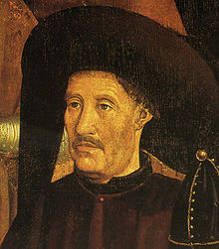
The Age of Exploration
It all began with “Prince Henry the Navigator.”
What About Henry?
Born in 4 March 1394 in Porto, Kingdom of Portugal
3rd son of John I of Portugal and Philippa of Lancaster
Died 13 November 1460
Place of death-Sagres, Kingdom of the Algarve

Slide 2
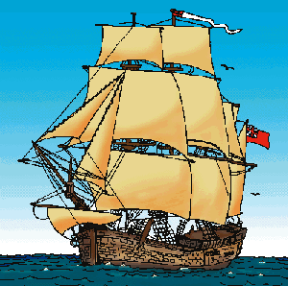
Henry as “The Navigator”
Henry never journeyed the sea
Henry organized expeditions
of sailors to explore the western
coast of Africa
In 1416, Henry founded the
School of Navigation in Sagres,
at the southwestern tip
of Portugal

Slide 3

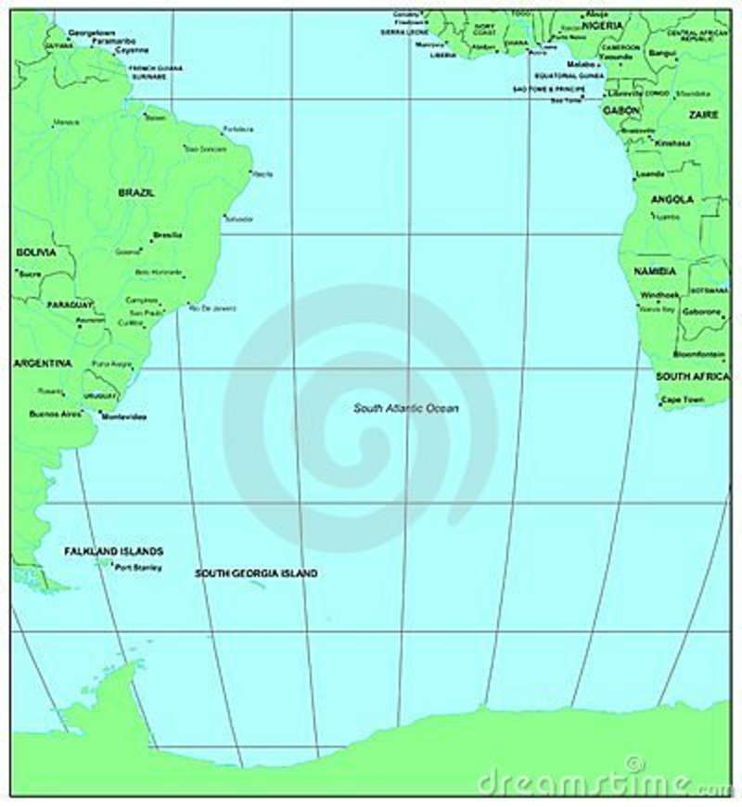
Henry as “The Navigator” Continued
Astronomers, geographers
and mathematicians study
and teach new methods of
navigation and traveling the seas
Expeditions were planned
using the latest maps, tools
and information about wind
currents in the Atlantic Ocean

Slide 4
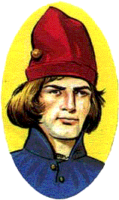
Who Were the explorers?
Gil Eanes
Born in Lagos, the Kingdom of Portugal and was the first person to sail beyond Cape Bojador
Eanes joined Henry’s expeditions in 1433
Henry wanted Eanes to round the Cape of Bojador
Eventually driven towards the Canary Islands
Captured natives while there and took them back to
Sagres
Sailed beyond Cape Bojador in 1434 and brought plants back to
Prince Henry to prove the voyage was a success

Slide 5
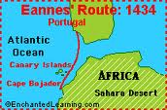
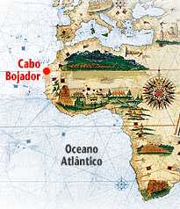
…and it all started with portugal
Because of Gil Eanes discovery of a safe passage around Cape Bojador, this marked the beginning of the Portuguese exploration of Africa

Slide 6
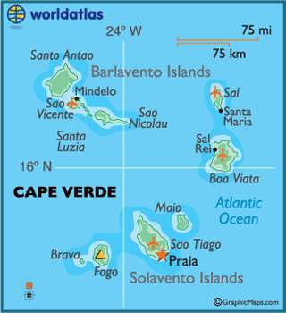
Who Were the Explorers?...Continued
Alvise Cadamasto
Born and Died in Venice, Italy (1432-18 July 1488)
Discovered the Cape Verde Islands
Cadamasto was recruited by Prince Henry to sail south
along the coast of Western Africa on 22 March 1455
Arrived in Senegal which had been explored by the
Portuguese
Proceeded towards Gambia
While in Gambia, Cadamasto observed the different
races, manners and customs of the people
The Natives of Gambia were very hostile
and Cadamasto returned to Portugal
Cadamasto returned again in 1456 under
Henry’s patronage and was driven further out
to sea by uncontrollable winds
Discovered the Cape Verde Islands in 1456

Slide 7
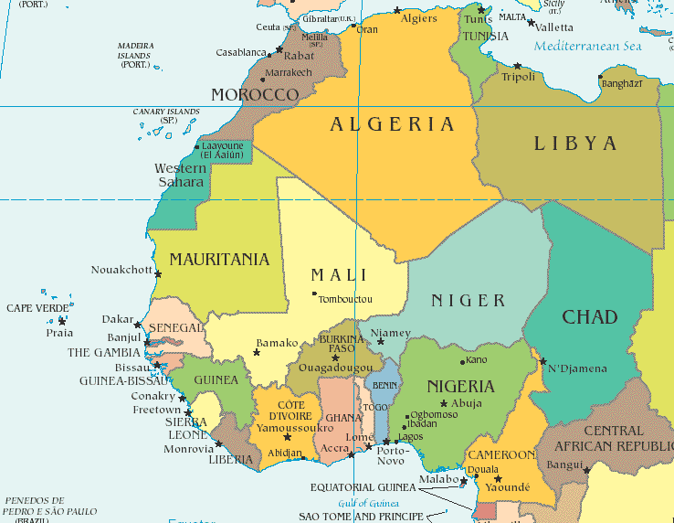
Test Your Geography Skills
Study this map of Western Africa very carefully. Next, you will label “The Voyages of Alvise Cadamasto” map and see exactly where and when he went on his trips to Western Africa for Prince Henry.

Slide 8
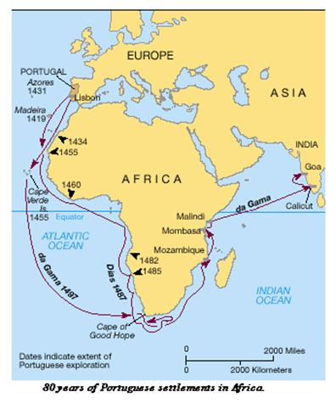
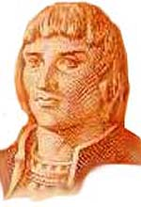
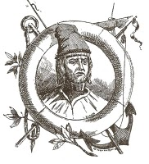
80 Years of Portuguese Exploration
Island of Porto Santo was (Madeira) was discovered in 1419 by Joao Goncalves Zarco and Tristao Vaz Teixeria
Both navigators were sent by Prince Henry to explore the African coast
Zarco and Teixeria were shipwrecked on the island
They returned to Portugal and Prince Henry ordered them to return and colonize the islands for Portugal
Joao Goncalves Zarco
Tristao Vaz Teixeria

Slide 9


How Madeira Grew and Helped Portugal
Chief producer of wheat in the
16th century (1700’s)
2) This helped Madeira’s economy
and population grow
Sugar Cane was grown when the prices for wheat began to fall
Expansion of Madeira was helped by the growth of Sugar Cane
Traders and settlers came to Madeira
In the 17th century (1800’s) vineyards began to produce wine

Slide 10
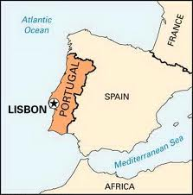
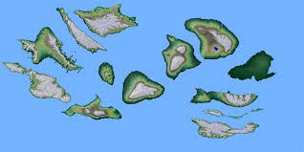
The Azores Islands
Discovered in 1431 by Portuguese seamen
Today is 907 miles from Lisbon
(Capital of Portugal)
Consists of 9 different islands
divided into 3 different parts
(Eastern, Central and Western Islands)
Azores are an Archipelago:
A wide stretch of water with
many scattered islands

Slide 11
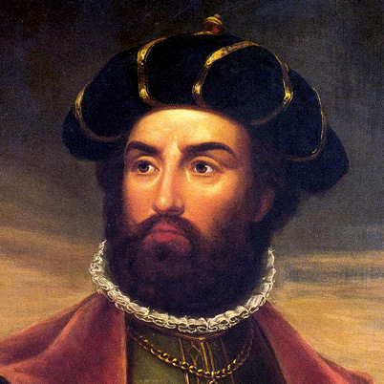
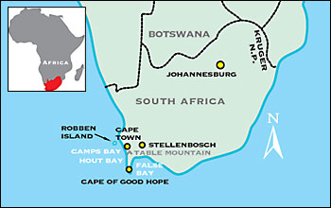
…Continuing with Vasco Da Gama
Born c. 1460 in Sines, Portugal
Born into a noble family as the son of Estevao da Gama
Joined the Navy when he was older and learned navigation
Commissioned by King Manuel of Portugal to find a route directly to India from Portugal
Portugal was now one of most powerful maritime countries in Europe
In 1487 Bartolomeu Dias rounded the Cape of Good Hope
Showed that the Atlantic and Indian Oceans were connected

Slide 12
The Voyages of Vasco da Gama
Da Gama wanted to prove Christopher Columbus wrong (Columbus thought that he had found a route to India when in fact he had found a route to the America’s
In 1502, da Gama led 10 ships on another journey to India
Along the East coast of Africa, da Gama and his crew terrorized Muslim ports
Next, they moved to Calicut and killed 38 people in the trade ports
After forming an alliance with the ruler of Cochin, da Gama and his crew left for Portugal on February 20, 1503 and returned to Portugal on October 11th.

Slide 13
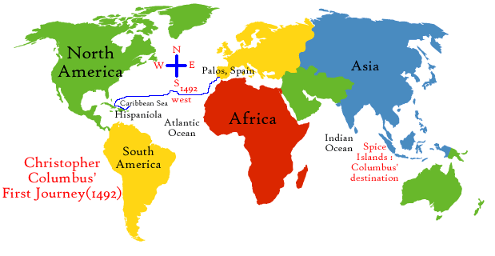



Christopher Columbus-Where was He Going?
Columbus asked for permission from Monarch’s in Spain and Portugal to sail to the far east to look for trade routes to the west
In 1492, Queen Isabella and King Ferdinand of Spain granted his request
Columbus promised to bring back gold, spices and silk from Asia
Columbus also promised to spread Christianity and to explore China
He also requested to be the Governor of the lands he discovered

Slide 14
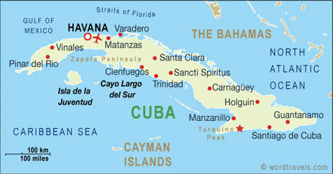
Columbus and the Nina, the Pinta and the Santa Maria
Columbus set sail on
August 3, 1492 and hit
land on October 12, 1492
Thinking that it was Asia,
Columbus named it
San Salvador
Still looking for China,
Columbus went on to Cuba
Columbus still never found the “riches” he was looking for

Slide 15
Columbus’s Remaining Voyages
On November 3, 1493, Columbus thought he had found the islands of Japan
The islands were Dominica, Guadeloupe and Jamaica
Columbus still found no riches and continued on his quest for Spain
On July 31, 1498, Columbus discovered Trinidad and Tobago, Grenada and Margarita
He also reached the South American mainland

Slide 16
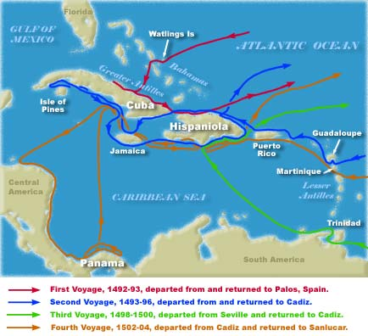
The End of the Voyage and Columbus’s Legacy
In 1502, Columbus would discover the following places (Central America and Panama)
Columbus Day is celebrated in the United States each year on the 2nd Monday in October
His major contribution and what he is often remembered for is that he was the first to visit, settle and stay in these lands for a period of time

Slide 17
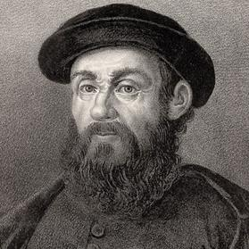

Ferdinand Magellan
Born c. 1480 in Sabrosa, Portugal
Died April 27, 1521 in Mactan, Philippines
Magellan, who was Portuguese but served Spain, led the first European voyage to circumnavigate the globe
Portugal was no longer willing to employ him after he was falsely accused of trading with the Moors
Magellan moved to Seville, Spain in 1517 to offer his navigational services to King Charles V
Magellan’s voyages proved once and for all that the Earth was Round

Slide 18
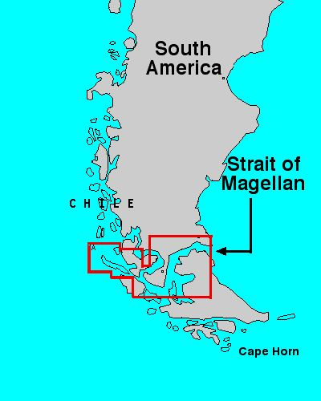
Magellan…The Final Years
Voyage to “circumnavigate” the globe began on September 20, 1519 (To go completely around especially by water)
October 1520, the fleet of ships entered what is today called the “Strait of Magellan”
The voyage thru the Strait of Magellan took about one month
One of the ship masters fled and sailed home to Spain

Slide 19
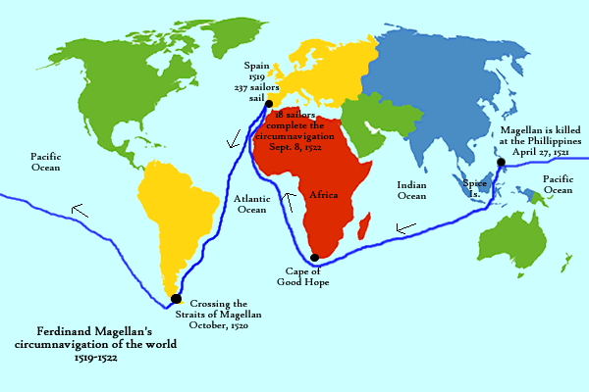
Circling the Globe…Finally

