Slide 1
Imperialism

Slide 2
Background
During the Industrial Revolution goods were being produced in large quantities. These goods were made from raw materials that Europeans could only get through trade.
Businesses began to realize that they could have a bigger profit if they could obtain raw materials at a lower cost.
The middle east and Africa had an abundance of raw materials (i.e gold, diamonds, petroleum, oil etc).
By gaining control over distant territory imperialist nations had easier access to the raw materials that were needed.

Slide 3
Scramble for Africa
European nations wanted parts of Africa because of the natural resources that can be found there.
Spain, Britain, Germany, France, Belgium, Portugal rushed to Africa to claim parts that were not already taken
These nations were at a competition that was escalating so a meeting was called and held in Berlin in 1884.

Slide 4
Berlin Conference
Nov. 15, 1884: The objective of this meeting was to settle ownership claims over the Congo River Basin
The decision was made that the Congo River Basin would be a neutral area used for European free trade. They also determined how the African territory would be divided amongst the european nations. (Nobody from Africa attended this meeting)
After the meeting European nations had agents met with different African leaders to get treaties signed. Europeans believed that the treaties gave them total control of the land, and the Africans saw them as a means of establishing a diplomatic relationship in which they could negotiate with the Europeans.

Slide 5
https://app.discoveryeducation.com/techbook2:concept/view/guidConceptId/0E34EB10-C3B6-44FA-8B2E-3E2547B490F7/guidUnitId/314CE74D-6D1E-4EA6-A640-6F8C6DC081FC#/tab=explore-tab&page=3&subTab=explore-main-tab

Slide 6
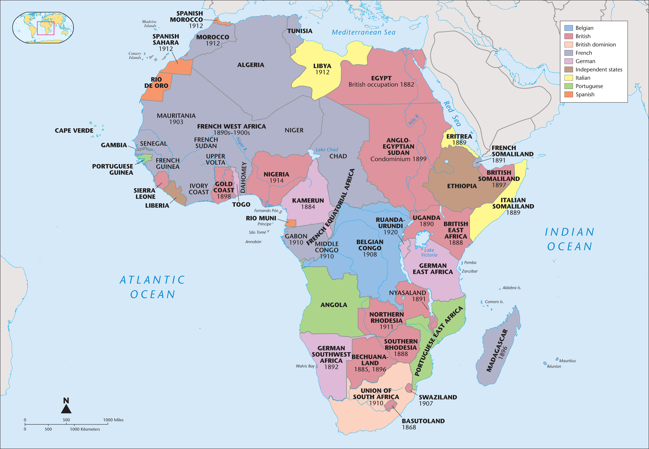
Partition of Africa 1800-1914

